Slide 1
ELITE RENT-A-CAR
MSCDA 5510
PREPARED BY –
BHAGYA SHREE
NAWAZ HUSSAIN
RAVNEET OBEROI
RISHAB GUPTA
VINAY GOVIND
VIVEK
GROUP 6

Slide 2
Case Facts
Case Extracts considered for Break Even analysis
Category | Avg Cost to Own | Avg Long Term (18-24 months) | Avg Short Term (< 12 months) | Insurance
Sports & Convertible | €40,000 | €450/month | €1000/month | €150
Four Wheel Drive | €60,000 | €600/month | €1000/month | €200
Exceptional | €200,000 | €2000/month | €3000/month | €400
Considering Amortization of 2% per month for a owned vehicle.
Maintenance of €30 per month for each car.

Slide 3
SPORTS & CONVERTIBLE
Sports and Convertible | Purchase | Lease (18-24 months) | Lease (< 12 months) | Average Rental Rate €400
Cost | €800 | €450 | €1000
Insurance | €150 | €150 | €150
Maintenance | €30 | €30 | €30
Overhead | €1000 | €1000 | €1000
Total Cost | €1980 | €1630 | €2180
Days/month | 4.95 | 4.07 | 5.45
Approximate | 5 | 5 | 6

Slide 4
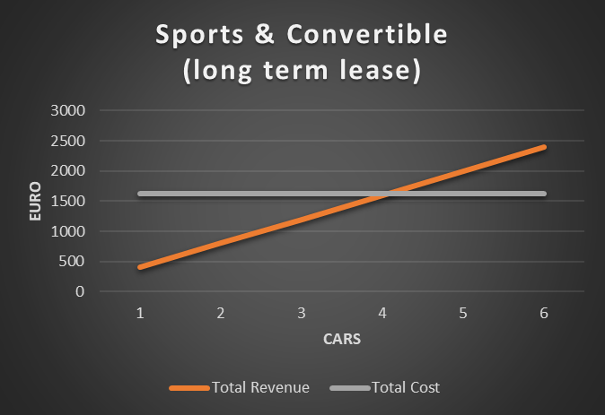
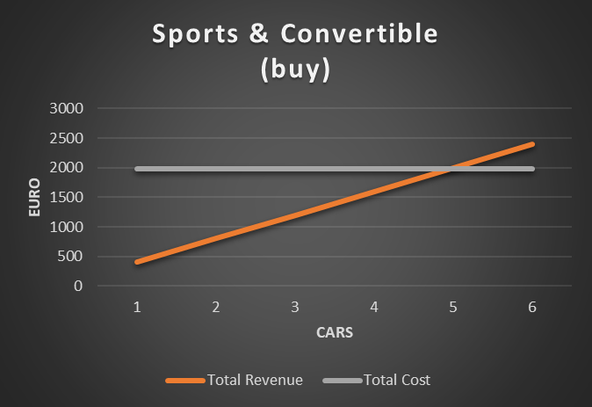
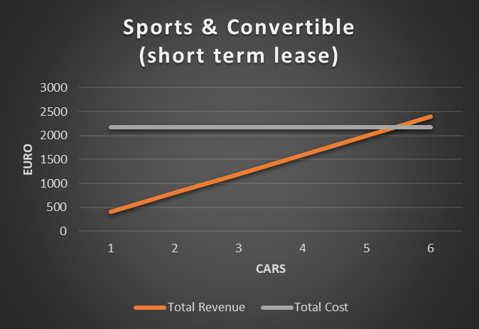

Slide 5
4 WHEEL DRIVE
4 wheel drive | Purchase | Lease (18-24 months) | Lease (< 12 months) | Average Rental Rate €550
Cost | €1200 | €600 | €1000
Insurance | €200 | €200 | €200
Maintenance | €30 | €30 | €30
Overhead | €1000 | €1000 | €1000
Total Cost | €2430 | €1830 | €2230
Days/month | 4.41 | 3.32 | 4.05
Approximate | 5 | 4 | 5
* Assumption of 1000 for overhead charges inclusive administrative expense and wages

Slide 6
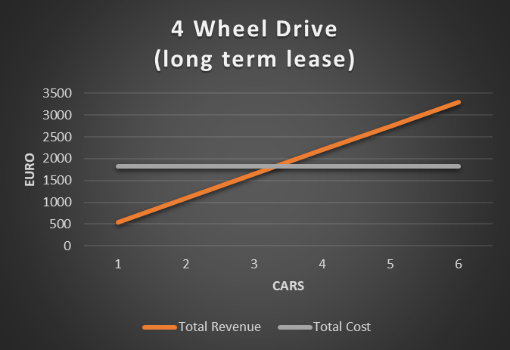
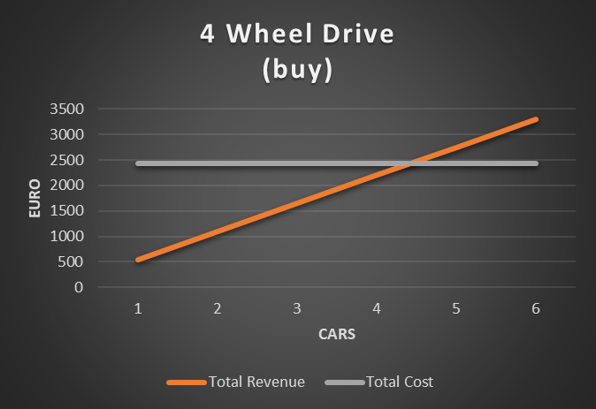
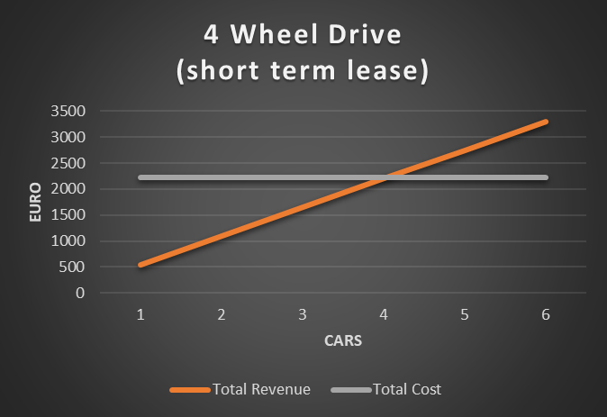

Slide 7
EXCEPTIONAL
Exceptional | Purchase | Lease (18-24 months) | Lease (< 12 months) | Average Rental Rates€1350
Cost | €4000 | €2000 | €3000
Insurance | €400 | €400 | €400
Maintenance | €30 | €30 | €30
Overhead | €1000 | €1000 | €1000
Total Cost | €5430 | €3430 | €4430
Days/month | 4.02 | 2.54 | 3.28
Approximate | 5 | 3 | 4

Slide 8
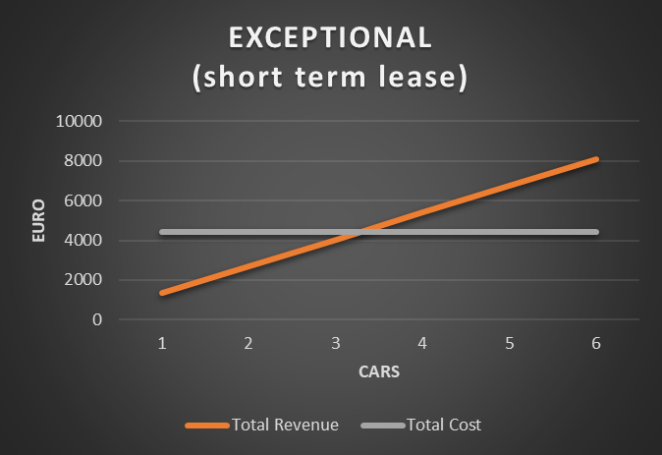
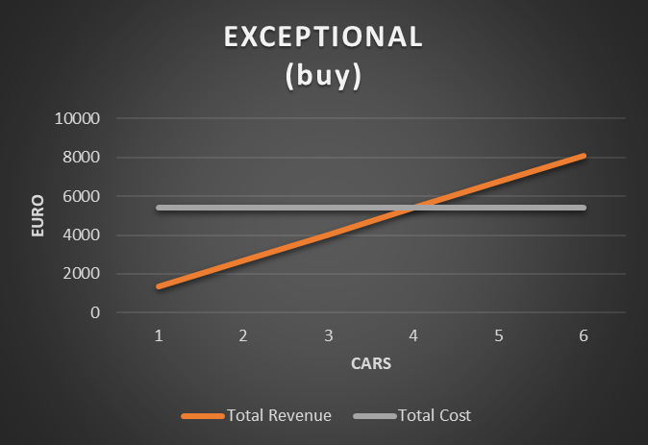
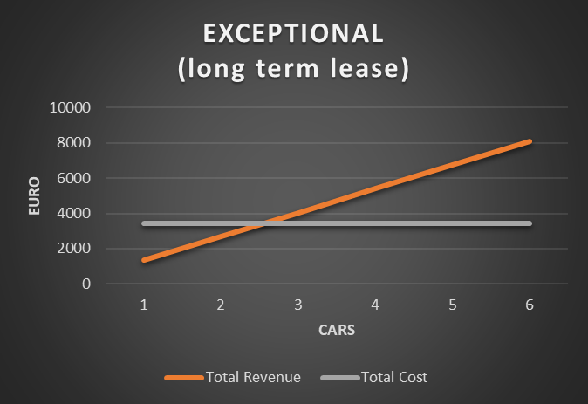

Slide 9
Optimal number of cars in each category
Assuming the demand for cars has increased by 60 % and the pattern of demand is similar to that of the previous year .
To find the optimal no of cars with no loss or profit in the 4 – wheel and Sports category, we take the following formula :
Profit (Probability of Success)- Loss(Probability of failure) =0

Slide 10
Optimal no of cars in Sports and convertible
With increase in demand bieng 60% we calculated the mean and median to be 13.39 and 7.54 respectively.
If we consider purchasing al l cars required for this category , them
0 =12000 *P – 1980 *(1-P) => P = 0.165
Calculating the Z score for 0.165 , it is 0.97
Hence 0.97 = (X- 13.39)/(7.54) => X =20.71~21
Similarly we have found out that the optimal no of the cars whether leased , bought or short-term leased would remain 21.

Slide 11
Optimal no of cars in 4 wheel drive
With increase in demand being 60% we calculated the mean and median to be 2.49 and 1.74 respectively.
If we consider purchasing al l cars required for this category , them
0 =16500 *P – 2430 *(1-P) => P = 0.147
Calculating the Z score for 0.147 , it is 1.05
Hence 1.05 = (X- 2.49)/(1.74) => X =4.32 ~5
Similarly we have found out that the optimal no of the cars whether leased , bought or short-term leased would remain 5.

Slide 12
Dividing Fleet
No
of
Day
s
Inferences drawn from the graph :
The demand of Sports and Convertible usage was higher in comparison to other catergories.
The Demand during July and August seemed to be higher than other months

Slide 13
Key Extract from the Case for Dividing Fleet
Elite prefers to purchase cars rather than leasing
Financing for Four Wheel Drive is not flexible, so Elite usually go with 18-24 months lease.
2 Million budget is for purchasing in two categories: S&C and Exceptional
Purchased cars can be sold anytime when they hit 15000km or 18 months
Company can make more profit for 18-24 months lease as it can cover two busy season .
Note:
Profit will be higher if
Company can sell purchased car anytime it hits 15000Km
The category which is high in demand should be given weightage to purchase because if they are leased , they might go over 15000Km and Elite would not be able to get of the lease.

Slide 14
Demand prediction for Sports & Convertible for 2006 summer
X-axis = number of cars rented in a day , Y-axis = frequency in %

Slide 15
Demand prediction for 4-WD 2006 summer
X-axis = number of cars rented in a day , Y-axis = frequency in %

Slide 16
Demand Prediction for Exceptional 2006 summer
X-axis = number of cars rented in a day , Y-axis = frequency in %

Slide 17
Composition of Fleet size
 | Purchase | Long term Leased cars | Short term leased | Total
S&C | 21 | 11 | - | 32
Four Wheel Drive | Finance is not flexible | 6 | - | 6
Exceptional | 3 | 2 | - | 5
Lets assume that we have total fleet size of 43
Total Purchase amount 2 million utilization for two category
Sports and Convertible :21 * 40000 = 840000
Exceptional : 3* 2000000 = 600000
Four Wheel Drive : Since Finance is not flexible for this category
Total = 1440000 =1.44 million
The demand will be fully met and all the cars will have optimum utilization.
Elite’s motto of ‘Not returning a single customer back’ will be achieved.
Company has utilized the budget allotted in the best possible way.
Buffer amount can be used for purchasing sports and convertible variant car –during the season as need permits.

